Slide 1
Lecture 01

Slide 2
Module 01

Slide 3
6
5
4
7
9
3
7
3
6
–5
–8
3
5
RATIONAL NUMBERS
9
7
6
4
3
3
5
–7
5
3
6

Slide 4


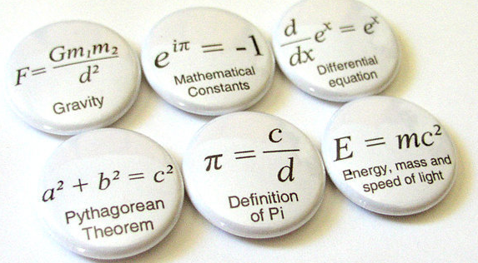
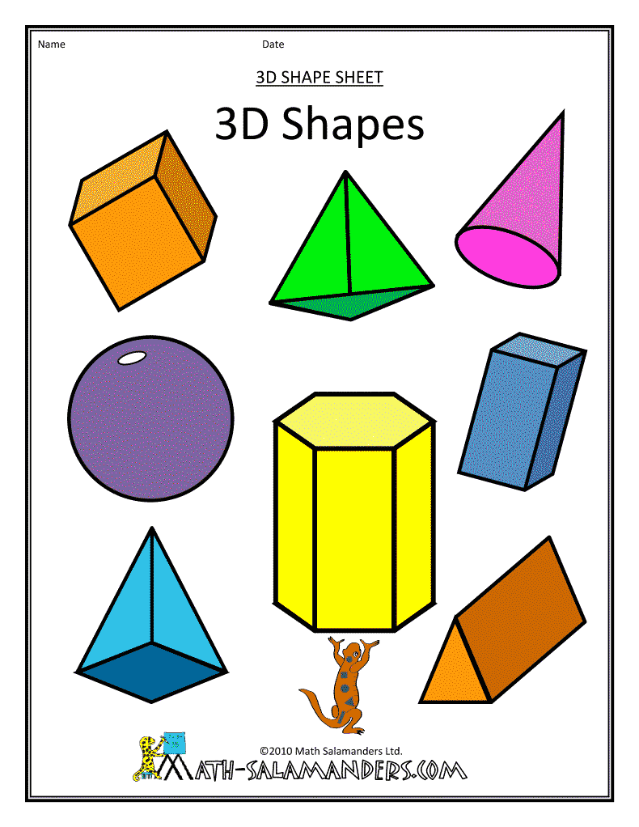
Numbers
Maths is the study of ?
MATHS ?
Formulae
Geometric Shapes

Slide 5

➲ Natural Number
Counting Numbers :
This number came to you naturally
Natural Numbers :
1 , 2 , 3 , 4 , 5 …..
Start Counting
Numbers
1, 2, 3, 4…

Slide 6




➲ Whole Number
Natural Numbers :
1 , 2 , 3 , 4 , 5 …..
The collection of number which includes all the natural number and zero
Whole Numbers :
0 ,
1 , 2 , 3 , 4 , 5 …..
An ancient Indian astronomer named ARYABHATT discovered zero
Natural Numbers start from 1
ZERO

Slide 7
➲ Integers Number
Natural Numbers :
1 , 2 , 3 , 4 , 5 …..
Whole Numbers :
0 ,
1 , 2 , 3 , 4 , 5 …..
Integers :
… - 3 , - 2 , - 1 ,
0 ,
1 , 2 , 3 , 4 , 5 …..
3
✓
It is a Natural Number
+ 4
It is a Whole Number
✓
 Write the biggest whole number.
Whole numbers start from 0 and goes “to infinity”
7
It is not possible to determine biggest whole number.
No limit
2
✗
It is a Natural Number
- 3
It is a Whole Number
✗
-1

Slide 8



COMMUTATIVITY
Two rational numbers can be added in any order
Operation
Numbers
Remarks
What do you observe ?
And
Addition
Addition is commutative
0
+
7
=
7
7
+
0
0
+
7
7
+
0
=
7
$$;$$
i.e.
0
+
7
=
7
+
0
Lets take an example
For any two whole numbers
a and b,
a
+
b
=
b
+
a

Slide 9
COMMUTATIVITY
Operation
Numbers
Remarks
What do you observe ?
And
Subtraction
Subtraction is not commutative
7
–
0
=
7
0
–
7
=
–7
$$;$$
Lets take an example
7
–
0
≠
0
–
7

Slide 10
COMMUTATIVITY
Two rational numbers can be multiplied in any order
Operation
Numbers
Remarks
What do you observe ?
And
Multiplication
Multiplication is commutative
0
×
7
=
0
7
×
0
0
×
7
7
×
0
=
0
$$;$$
i.e.
0
×
7
=
7
×
0
Lets take an example
For any two whole numbers
a and b,
a
×
b
=
b
×
a

Slide 11



COMMUTATIVITY
Operation
Numbers
Remarks
Division
What do you observe ?
And
Division is not commutative
7
$$\text{÷}$$
0
N.d
÷
=
0
7
=
0
$$;$$
Lets take an example
7
$$\text{÷}$$
0
≠
0
$$\text{÷}$$
7

Slide 12
Module 02

Slide 13

















ASSOCIATIVITY
Three rational numbers can be grouped in any order
Operation
Numbers
Remarks
What do you observe ?
And
Addition
Addition is associative
(7$+$2)
7
$$+$$
$+$5
(2$+$5)
=
14
(7$+$2)
7
$$+$$
$+$5
=
14
(2$+$5)
$$;$$
i.e.
=
(7$+$2)
7
$$+$$
$+$5
(2$+$5)
Lets take an example...
For any three whole numbers
a, b and c
a
=
(b
$$+$$
c)
$$+$$
(a
b)
$$+$$
$$+$$
c

Slide 14









ASSOCIATIVITY
Operation
Numbers
Remarks
What do you observe ?
And
Subtraction
Subtraction is not associative
7
$$–$$
(2$−$5)
=
10
(7$−$2)
$$;$$
$−$5
=
0
Lets take an example
7
$$–$$
(2$−$5)
≠
(7$−$2)
$−$5

Slide 15








ASSOCIATIVITY
Three rational numbers can be grouped in any order
Operation
Numbers
Remarks
What do you observe ?
And
Multiplication
Multiplication is associative
(7×2)
7
$$×$$
×5
(2×5)
=
70
(7×2)
7
$$×$$
×5
=
70
(2×5)
$$;$$
7
$$×$$
=
i.e.
(2×5)
(7×2)
Lets take an example
×5
For any two whole numbers
a, b and c
a
=
(b
$$×$$
c)
$$×$$
(a
b)
$$×$$
$$×$$
c

Slide 16









ASSOCIATIVITY
Operation
Numbers
Remarks
What do you observe ?
And
Division
Subtraction is not associative
7
$$÷$$
(2$÷$5)
=
17.5
(7$÷$2)
$$;$$
$÷$5
=
0.7
Lets take an example
7
$$÷$$
(2$÷$5)
≠
(7$÷$2)
$÷$5

Slide 17





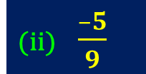
Additive Inverse
Q.1)
Write the additive inverse of each of the following.
Examples:
Negative of Integers
Negative of Integers
(i) $\frac{2}{8}$
$$\frac{2}{8}$$
× –1
=
$$\frac{–2}{8}$$
Sol.
(ii) $\frac{–5}{9}$
$$\frac{–5}{9}$$
× –1
=
$$\frac{5}{9}$$
Sol.

Slide 18

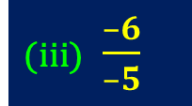


Additive Inverse
Q.1)
Write the additive inverse of each of the following.
Examples:
Negative of Integers
(iii) $\frac{–6}{–5}$
$$\frac{–6}{–5}$$
=
$$\frac{6}{5}$$
=
$$\frac{6}{–5}$$
Sol.
× –1

Slide 19





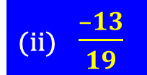
Multiplicative Inverse
Q.2)
Write the multiplicative inverse of each of the following.
Examples:
Reciprocal of Integers
Reciprocal of Integers
(i) $–13$
$$–13$$
=
$$\frac{1}{–13}$$
Sol.
(ii) $\frac{–13}{19}$
$$\frac{–13}{19}$$
=
$$\frac{19}{–13}$$
Sol.

Slide 20
Module 03

Slide 21

EXERCISE
Find using distributivity
Q.
7
−3
7
5
×
+
×
5
12
5
12
What are the uncommon factors?
What are the common factors?
Since denominator is same
Sol.
7
7
7
−3
7
5
7
− 3
5
5
×
+
5
×
=
×
+
5
12
5
12
5
12
12
7
− 3
+
5
=
×
5
12
7
1
2
=
×
5
12
6
7
=
30

Slide 22
EXERCISE
Using appropriate properties find:
1
What are the uncommon factors?
2
3
1
3
1
2
What are the common factors?
Q.
×
−
−
×
+
×
5
7
6
2
14
5
2
Sol.
2
−3
1
2
1
=
×
+
×
−
(Using commutativity)
5
7
14
5
4
=
2
−3
1
1
+
−
(Using distributivity)
5
7
14
4
−42
–4
–7
2
+
7
1
=
−
=
5
98
4
28
1
–11
1
7
=
=
2
×
–35
1
28
−
5
98
4
1
49
–1
7
=
1
−
7
4

Slide 23
Module 04

Slide 24
Q. Using appropriate properties find
2
3
5
3
1
−
×
+
−
×
3
5
2
5
6
What are the uncommon factors?
2
3
5
3
1
What are the common factors?
Sol.
−
×
+
−
×
3
5
2
5
6
=
2
3
3
1
5
−
×
−
×
+
(Using associativity)
3
5
5
6
2
−
1
3
2
+
5
(Using distributivity)
=
−
5
3
6
2
–2 × 2
1
–
3 × 2
− 1 + 5
3
− 4 − 1
5
=
6
=
+
–4
1
2
=
–
5
6
2
2
6
4
=
6
1
− 5
5
2
3
×
+
1
=
5
6
2
2
=
2
1
5
=
−
+
2
2

Slide 25

Q.
Name the property under multiplication used in each of the following:
Sr. No.
Is this in the form of a × 1 = 1 × a = a
Rational number
Multiplicative inverse
(i)
–4
–4
4
1 is the multiplicative identity
×
1 = 1 ×
=
–
When we multiply rational number with 1, we get rational number as the product
5
5
5
a
1
1
a
we get that rational number as the product

Slide 26
Lecture 02

Slide 27
Module 05

Slide 28
EXERCISE
Q.
Write five rational numbers which are smaller than 2.
Sol.
1
1
1
–1
–1
,
,
,
,
,
3
4
2
2
5
and so on.

Slide 29
Q.
Find ten rational numbers between:
–2
and
1
Q.
5
2
–2
1
Converting
and
having same
Sol.
5
2
–2
×
denominators such that difference between the numerators is more than 10.
–2
2
–4
2
–8
=
=
×
=
5
5
×
2
10
Same denominators
×
2
20
1
1
×
5
5
2
10
The difference between the numerators is not more than 10
=
=
×
=
2
2
×
5
10
×
2
20
–2
and
1
–4
5
Ten rational numbers between are
Converting
and
having same
5
2
10
10
denominators such that difference between the numerators is more than 10.
–7
–6
–5
–4
–3
–2
–1
1
2
,
,
,
,
,
,
,
,
,
0
20
20
20
20
20
20
20
20
20

Slide 30
Q.
Find five rational numbers between:
1
and
1
Q.
4
2
1
1
Converting
and
having same
Sol.
4
2
1
×
denominators such that difference between the numerators is more than 5.
1
1
1
8
8
=
=
×
=
4
4
×
1
4
Same denominators
×
8
32
1
1
×
2
2
8
16
The difference between the numerators is not more than 5
=
=
×
=
2
2
×
2
4
×
8
32
1
and
1
1
2
Five rational numbers between are
Converting
and
having same
4
2
4
4
9
10
11
12
13
denominators such that difference between the numerators is more than 5.
,
,
,
,
32
32
32
32
32

Slide 31
Module 06

Slide 32
EXERCISE
–(–x) = x
we need to prove
Q.
Verify that –(–x) = x for :
x
=
−
13
17
Sol.
In order to find –x
But
–13
is the value of x
x
=
–13
…(i)
17
17
–(–x)
13
=
–
…(ii)
Multiplying –1 on both the side
17
– – = +
–1 × x
=
–1×
13
−
–(–x)
=
x
[ From (i) and (ii)]
17
In order to find –(–x)
13
Hence proved
– x
=
+
17
Multiplying –1 on both the side
– + = –
–1 × (–x)
=
–1×
+
13
17

Slide 33
EXERCISE
What are next number between 40 to 48?
41
42
43
44
45
41
42
43
44
45
Q.
Find five rational numbers between:
60
60
60
60
60
60
60
60
60
60
2
and
4
Q.
3
5
2
4
Converting
and
having same
Sol.
3
5
2
2
×
20
40
denominators such that difference between the numerators is more than 5.
=
=
3
3
×
20
60
Same denominators
4
4
×
12
48
=
=
5
5
×
12
60
41
42
43
44
45
Now, any five rational numbers are
60
60
60
60
60

Slide 34
EXERCISE
Q.
Find five rational numbers between:
What are next number between –9 to –10 ?
–8
–7
–6
1
2
–8
–7
–6
1
2
–3
and
5
…
Q.
6
6
6
6
6
2
3
6
6
6
6
6
2
4
Converting
and
with same
Sol.
3
5
–3
×
denominators. we have
–3
3
– 9
=
=
2
2
×
3
6
Same denominators
5
5
×
2
10
=
=
3
3
×
2
6
–8
–7
–6
1
2
∴ Five rational numbers are
6
6
6
6
6

Slide 35
EXERCISE
Q.
Find five rational numbers between
3
and
3
5
What are numbers between 60 to 75 ?
4
61
62
63
64
65
3
3
61
62
63
64
65
Q.
and
3
3
100
100
100
100
100
100
100
100
100
100
5
4
Converting
and
such that they
5
4
have common denominators and their numerators have, difference of more than 10, i.e
66
67
68
69
70
Sol.
66
67
68
69
70
…
3
3
×
20
60
=
=
100
100
100
100
100
100
100
100
100
100
5
5
×
20
100
Same denominators
3
3
×
25
75
=
=
4
4
×
25
100
∴ Ten rational numbers are
61
62
63
64
65
66
67
68
69
70
100
100
100
100
100
100
100
100
100
100

Slide 36
Module 07

Slide 37
Q.
Find the multiplicative inverse of the following
Reciprocal
2
What is the reciprocal of
5
What is the reciprocal of
–1
Sr. No.
Rational number
Multiplicative inverse
1
(i)
–1
–2
2
5
×
=
5
5
2
5
(ii)
– 1
– 1
2
–1
= –1
1

Slide 38
Q.
Verify that –(–x) = x for :
11
We need to prove
x
=
15
Sol.
In order to find –x
But
11
is the value of x
x
=
11
…(i)
15
15
–(–x)
11
=
…(ii)
Multiplying –1 on both the side
15
–1 × x
=
–1×
11
15
–(–x)
=
x
[ From (i) and (ii)]
In order to find –(–x)
11
Hence proved
– x
=
–
15
Multiplying –1 on both the side
– × – = +
–1 × (–x)
=
–1×
–
11
15

Slide 39
Module 08

Slide 40
EXERCISE
Q.
Find the multiplicative inverse of the following
Reciprocal
–13
What is the reciprocal of
1
Sr. No.
Multiplicative inverse
Rational number
–1
–13
What is the reciprocal of
–1
13
19
(i)
– 13
1
13
What is the reciprocal of
–13
–19
–19
5
(ii)
13
15
What is the reciprocal of
19
13
5
56
(iii)
1
5
1
5
56
(iv)
–5
–3
15
56
15
×
=
8
7
56
15
(–5)
×
(–3)
×
7
8
15
=
15
56
56

Slide 41

EXERCISE
Q.
Name the property under multiplication used in each of the following
What is the reciprocal of
–19
29
Sr. No.
Multiplicative
Property used
Is this in the form of a × b = b × a
(i)
13
–2
–2
–13
29
–
×
=
×
Commutativity
Whenever a number multiplied by its reciprocal then which property is used?
17
7
7
17
–19
(ii)
a
b
a
b
So what is the property called as ?
–19
29
Multiplicative inverse
×
29
–19
Commutativity
Multiplicative inverse

Slide 42
EXERCISE
Q.
Multiply
6
by the reciprocal of
–7
13
16
–7
What is the reciprocal of
16
6
×
−7
∴
Reciprocal of
13
16
–16
6
– 16
7
∴
×
13
7
6
×
(−16)
=
13
×
7
=
−96
91

Slide 43
Lecture 03

Slide 44
Module 09

Slide 45

Q.
Tell what property allows you to compute
1
4
1
4
Is this in the form of a ×(b × c) = (a × b) × c
×
as
6
×
×
6
×
3
3
3
3
a
b
c
a
b
c
So what is the property called as ?
1
4
as
1
4
×
6
×
×
In computing
6
×
3
3
3
3
Associativity
we use the associativity property.

Slide 46
Q.
8
1
Is the multiplicative inverse of why or why not ?
9
– 1
8
The product of a rational number and its multiplicative inverse is equal to 1.
8
1
Sol.
–
×
1
9
8
8
– 9
– 1
=
×
9
8
=
– 1
≠
1
8
1
–1
is not the multiplicative inverse of
because the product is not 1.
9
8

Slide 47
1
Q.
Is 0.3 the multiplicative inverse of why or why not ?
3
3
Sol.
1
The product of a rational number and its multiplicative inverse is equal to 1.
0.3
×
3
3
3
10
=
×
10
3
=
1
1
∴ 0.3 is the multiplicative inverse of
as the product is 1.
3
3

Slide 48
Module 10

Slide 49
Q. Write.
1
The rational number that does not have a reciprocal
Sol.
0
2
The rational numbers that are equal to their reciprocals.
Sol.
1 and – 1
3
The rational number that is equal to its negative.
Sol.
0

Slide 50
Q. Fill in the blanks:
(i)
No
Zero has ______ reciprocal.
(ii)
1
– 1
The numbers _____ and ____ are their own reciprocals.
– 1
(iii)
The reciprocal of – 5 is ___.
5
1
x
(iv)
Reciprocal of ,where x ≠ 0 is
___.
x
The product of two rational numbers is always a _________________.
(v)
Rational Number
The reciprocal of a positive rational number is _________ .
(vi)
Positive

Slide 51
Module 11

Slide 52
Q. Simplify
8
4
+
–15
–3
8
4
Denominators of both rational numbers are not equal
Sol.
+
Denominators of both rational numbers are not positive
Lets make them equal by taking L.C.M
Lets add the numerators
Multiply & divide by –1
–15
–3
L.C.M of 15 and 3 is 15
×
×
8
–1
4
–1
=
+
–3
–15
×
–1
×
–1
?
3
5
–8
–4
×
=
15
=
+
15
3
×
–8
–4
5
Denominators
are equal
=
+
15
3
×
5
–8
–20
=
+
15
15
+
(–20)
–8
=
15
–
–8
20
=
15
–28
=
15

Slide 53

5
3
Denominators of both rational numbers are positive
Q. Add
and
12
8
?
12
×
2
=
24
2
12, 8
?
8
3
5
3
×
=
24
2
6,
4
Sol.
+
12
8
Denominators of both rational numbers are not equal
2
3,
2
×
×
5
2
3
3
3,
1
=
+
Denominators
are equal
3
12
8
×
3
×
2
Lets add the numerators
1,
1
10
9
Lets make them equal by taking L.C.M
LCM of 12 and 8
=
+
24
24
=
2 × 2 × 2× 3
+
=
24
10
9
=
24
19
=
24

Slide 54
Q. Simplify
7
16
+
–26
39
Denominators of both rational numbers are not equal
Lets make them equal by taking L.C.M
13
26, 39
Sol.
7
16
2
2,
3
+
–26
39
Multiply & divide by –1
3
1,
3
×
16
7
–1
+
=
1,
1
–26
39
×
–1
?
LCM of 26 and 39
39
×
2
–7
16
=
78
=
+
=
13 × 2 × 3
26
39
?
=
78
26
3
×
=
78
–7
Lets add the numerators
×
3
16
×
2
=
+
Denominators
are equal
26
×
3
39
×
2
–21
32
=
+
78
78
+
–21
32
=
78
11
=
78

Slide 55
Module 12

Slide 56
–7
5
–5
1
–1
Denominators of each rational numbers are not equal
Q. Find
+
?
+
+
+
?
4
×
3
12
?
?
=
12
4
12
4
3
×
=
4
3
3
×
=
12
6
3
2
6
×
2
=
Lets make them equal by taking L.C.M
Lets find L.C.M of 4, 3, 6 & 2
?
12
2
4, 3, 6, 2
2
×
6
=
Sol.
–7
5
–5
1
–1
2
2,
3,
3,
1
+
+
+
+
4
3
6
3
2
3
1,
3,
3,
1
×
×
×
×
×
–1
6
–7
3
5
4
–5
2
1
4
1,
1,
1,
1
=
+
+
+
+
4
×
3
3
×
4
6
×
2
3
×
4
2
×
6
LCM of 4,3,6,2
–21
20
–10
4
–6
=
2 × 2 × 3
=
+
+
+
+
12
12
12
12
12
=
12
–21
+
20
+
(–10)
4
(–6)
+
+
=
12
+
24
–37
=
12
–13
=
12

Slide 57
–12
–7
3
1
–1
Denominators of each rational numbers are not equal
?
+
+
+
+
Q. Evaluate
140
?
?
?
5
28
×
=
140
20
140
7
7
×
=
20
140
×
=
10
5
20
14
×
=
14
7
10
Lets make them equal by taking L.C.M
?
140
2
5, 20, 14, 7, 10
10
×
14
=
–12
–7
3
1
–1
5
5,
10,
7,
7,
5
Sol.
+
+
+
+
5
20
14
7
10
7
1,
2,
7,
7,
1
×
×
×
×
×
–1
14
–12
28
–7
7
3
10
1
20
2
1,
2,
1,
1,
1
=
+
+
+
+
10
5
×
28
20
7
×
20
×
14
×
7
14
×
10
1,
1,
1,
1,
1
–336
–49
30
20
–14
=
+
+
+
+
LCM of 5, 20, 14, 7, 10
140
140
140
140
140
=
2 × 5 × 7 × 2
–336
(–49)
30
20
(–14)
+
+
+
+
=
140
=
140
+
50
–399
=
140
–349
=
140

Slide 58
Module 13

Slide 59
EXERCISE
Prove that :
Now open the Bracket
Now let us solve RHS
Now open the Bracket
–3
8
8
–3
Let us 1st take LHS
Q.
×
=
×
16
15
15
16
Sol.
1
–3
8
(–3)
×
8
–24
–1
LHS
=
×
=
=
=
16
15
16
×
15
240
10
10
1
8
–3
8
–24
–1
×
(–3)
=
=
RHS
=
×
=
15
16
15
×
16
240
10
10
∴
LHS
=
RHS
–3
8
8
–3
Hence,
×
=
×
16
15
15
16

Slide 60
EXERCISE
Let us group the term with same denominator
Solve :
Since there are equal denominator
3
+
7
− 11
+
–2
Since there are equal denominator
Q.
+
5
3
5
3
3
7
−11
–2
3
−11
7
−2
+
+
+
=
+
+
+
Sol.
5
3
5
3
5
5
3
3
{ 3
+
(−11)}
{ 7
+
(−2)}
=
+
5
3
–8
+
5
=
5
3
(−24
+
25)
=
15
1
=
15

Slide 61
Lecture 04

Slide 62
Module 14

Slide 63
–3
4
9
–10
1
3
Q. Solve
×
+
×
–
×
2
5
5
3
2
4
–3
4
9
–10
1
3
Sol.
×
+
×
–
×
2
5
5
3
2
4
2
3
2
–3
×
4
9
×
–10
1
×
3
=
+
–
2
×
5
5
×
3
2
1
1
1
×
4
L.C.M of 5, 1 ,8 is 40
–3
×
2
3
×
–2
1
×
3
=
+
–
1
?
?
×
5
1
×
1
2
×
4
40
?
5
8
40
×
=
40
1
×
=
5
40
8
×
=
–6
–6
–3
=
+
+
5
1
8
×
×
×
–6
8
–6
40
3
5
=
+
–
5
×
8
1
×
40
8
×
5
–48
240
15
=
–
–
40
40
40
–
240
15
–48
–
=
40
–303
=
40

Slide 64
–7
×
15
1
1
1
Q.
–
×
1
+
×
18
–7
4
2
4
2
6, 4, 8
Sol.
–7
15
1
1
1
1
Lets make them equal by taking L.C.M
×
–
×
+
×
18
–7
1
4
2
4
2
3,
2,
4
1
–7
5
×
15
1
×
1
1
×
1
2
3,
1,
2
=
–
+
18
×
–7
1
×
4
2
6
1
×
4
1
3
3,
1,
1
×
5
1
×
1
1
?
×
1
=
–
+
24
?
6
4
6
×
=
×
1
1
×
4
2
×
4
24
×
4
1,
1
6
=
?
1,
8
3
24
5
1
1
×
=
=
–
+
L.C.M of 6, 4, 8
6
4
8
5
×
4
1
×
6
1
×
3
=
2 × 2 × 2 × 3
=
–
+
6
×
4
4
×
6
8
×
3
=
24
20
–
6
+
3
=
24
24
24
20
–
6
+
3
=
24
23 – 6
=
24
17
=
24

Slide 65
Module 15

Slide 66








EXERCISE
Let us assume
a
b
27
− 15
÷
(….)
Q. Fill in the blanks :
=
16
8
Sol.
27
a
–15
What is the reciprocal of $\frac{a}{b}$ ?
÷
=
16
b
8
= $\frac{b}{a}$
27
b
–15
×
=
To convert ÷ to ×
16
a
8
5
2
b
–15
16
What is the reciprocal of $\frac{–10}{9}$ ?
= $\frac{–9}{10}$
∴
=
×
a
8
27
1
9
But, we have to find the value of $\frac{a}{b}$
b
–10
∴
a
=
9
a
–9
∴
=
b
10
Hence, the missing number is
–9
10

Slide 67


EXERCISE
Q. What number should be added to $\frac{–7}{8}$to get $\frac{4}{9} ?$
Sol.
Let the other number to be added be x
We have to find the value of x
−7
4
x
+
=
8
9
4
–7
∴
x
=
–
9
8
4
7
∴
x
=
+
9
8
(32
+
63)
∴
x
=
72
∴
x
=
95
72
Hence, the required number is
95
72

Slide 68

EXERCISE
Since x is subtracted from
–7
Q. What number should be subtracted from $\frac{–5}{7}$to get –1 $?$
16
Sol.
Let the other number to be subtracted be x
−5
–
x
=
–1
7
–5
∴
–x
=
–1
–
We have to find the value of x
7
–1
5
∴
–x
=
+
1
7
(–7
+
5)
∴
–x
=
7
∴
–x
=
–2
7
∴
x
=
2
7
Hence, the required number is
2
7

Slide 69

EXERCISE
Q .
The sum of two rational numbers is -5. If one of them is $\frac{−13}{6}. Find the other$
Sol.
+
−13
–5
x
=
6
Let the other number be x.
–13
∴
x
=
–5
–
6
∴
x
=
–5
13
+
1
6
(−30
+
13)
∴
x
=
6
∴
x
=
−17
6
Hence, the required number is
−17
6

Slide 70
Module 16

Slide 71
EXERCISE
Q.
Tell what property allows you to compute
1
4
1
4
Is this in the form of a ×(b × c) = (a × b) × c
×
as
6
×
×
6
×
3
3
3
3
a
b
c
a
b
c
So what is the property called as ?
1
4
as
1
4
×
6
×
×
In computing
6
×
3
3
3
3
Associativity
we use the associativity

Slide 72
EXERCISE
Q.
Represent
7
on the number line
4
Give Denominator ‘4’ to each number
Draw a number line
8
7
4
is 2
Q.
is 1
4
4
4
A
8
0
1
2
3
4
2
1
2
3
1
5
6
7
9
4
5
6
7
8
10
4
4
4
4
4
4
4
4

Slide 73
EXERCISE
–2
–5
–9
Q.
Represent
,
,
on the number line
11
11
11
Give Denominator ‘11’ to each number
–11
Draw a number line
–2
–5
–9
is –1
Q.
,
,
11
11
11
11
C
B
A
–1
–5
–11
–10
–9
–8
–7
–6
–4
–3
–2
–1
0
1
2
3
4
5
6
7
8
9
10
11
11
11
11
11
11
11
11
11
11
11
11

Slide 74
EXERCISE
Q.
Represent
–5
on the number line
6
Give Denominator ‘6’ to each number
–6
Draw a number line
–5
is –1
Q.
6
6
B
–9
–8
–7
–1
–5
2
–6
–4
–3
–2
–1
0
1
3
4
5
6
7
8
9
6
6
6
6
6
6
6
6
6

Slide 75
Module 17

Slide 76













Which of the numbers $\frac{3}{–4}$ and $\frac{–5}{6}$ is greater ?
Example 1
Sol.
$$\frac{3}{–4}$$
3 × (–1)
$$\frac{–3}{4}$$
$$\frac{–5}{6}$$
One number
=
=
=
The other number
-4 × (–1)
Which is the greater number from –9 & – 10?
LCM of 4 and 6
=
$$12$$
To compare the number
What should
be multiplied to 6 to get 12 ?
12
What should
be multiplied to 4 to get 12 ?
(–3)
Multiply the fraction by –1
What is LCM of 4 and 6
$$\frac{–3}{4}$$
× 3
$$\frac{–9}{12}$$
∴
=
First we write each of the given numbers with positive denominator
=
First we make the equal denominator
4
× 3
3
Take LCM
(–5)
$$\frac{–5}{6}$$
× 2
$$\frac{–10}{12}$$
2
∴
=
=
6
× 2
∴
–9
>
–10
Hence, $\frac{3}{–4}$ $>$ $\frac{–5}{6}$
∴

Slide 77












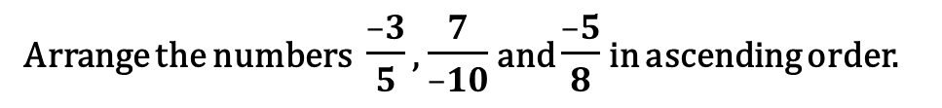



Arrange the numbers $\frac{–3}{5}$ , $\frac{7}{–10}$ and $\frac{–5}{8}$ in ascending order.
Example 2
Sol.
$$\frac{7}{–10}$$
7 × (–1)
$$\frac{–7}{10}$$
Working
We have
=
=
(–10) × (–1)
Let us compare three of the numerators
5
,8
Which is the smaller number from –28 , –25 & – 24?
5
,10
2
1
,8
$$\frac{–3}{5},\frac{–7}{10}and\frac{–5}{8}$$
,2
Thus, the given numbers are
2
1
,4
What should
be multiplied to 5 to get 40 ?
,1
First we write each of the given numbers with positive denominator
Multiply the fraction by –1
What is LCM of 5,10and 8?
LCM of 5,10 and 8 is 40
2
1
,2
What should
be multiplied to 8 to get 40 ?
,1
To arrange the number
What should
be multiplied to 10 to get 40 ?
(–3)
$$\frac{–3}{5}$$
× 8
$$\frac{–24}{40}$$
1
,1
∴
=
=
,1
5
40
× 8
First we make the equal denominator
(–7)
$$\frac{–7}{10}$$
× 4
$$\frac{–28}{40}$$
∴
=
Take LCM
=
10
× 4
8
5
(–5)
4
$$\frac{–5}{8}$$
× 5
$$\frac{–25}{40}$$
∴
=
=
8
× 5
∴
$$\frac{–28}{40}$$
$$\frac{–25}{40}$$
$$\frac{–24}{40}$$
Hence $\frac{–7}{10}$ $<$ $\frac{–5}{8}$ $<$ $\frac{–3}{5}$ i.e., $\frac{7}{–10}$ $<$ $\frac{–5}{8}$ $<$ $\frac{–3}{5}$
<
<

Slide 78
Module 18

Slide 79








Q.)
Which of the following is greater:
(i) $\frac{4}{–5}$ , $\frac{–7}{10}$
Which is the smaller number from – 8 & – 7 ?
Sol.
=
$$\frac{4}{–5}$$
4 × (–1)
$$\frac{–4}{5}$$
We have,
=
=
–5 × (–1)
What should
be multiplied to 10 to get 10 ?
What should
be multiplied to 5 to get 10 ?
What is LCM of 5 and 10?
LCM of 5 and 10
=
10
To compare the number
Multiply the fraction by –1
First we write each of the given numbers with positive denominator
–4
$$\frac{–4}{5}$$
× 2
$$\frac{–8}{10}$$
∴
=
=
First we make the equal denominator
5
× 2
10
Take LCM
1
(–7)
2
$$\frac{7}{10}$$
× 1
$$\frac{–7}{10}$$
∴
=
=
10
× 1
∴
–8
<
–7
Hence, $\frac{4}{–5}$< $\frac{–7}{10}$
∴

Slide 80















Q.)
Arrange the following rational numbers in descending order :
(ii) $\frac{–5}{6}$ , $\frac{–7}{12}$ ,$\frac{–13}{18}$ ,$\frac{23}{–24}$
What should
be multiplied to 24 to get 144?
Which is the greater number from – 120, – 84, –104 & –138 ?
Sol.
=
$$\frac{23}{–24}$$
23 × (–1)
$$\frac{–23}{24}$$
We have,
=
=
What should
be multiplied to 18 to get 144?
–24 × (–1)
What is LCM of 6,12,18 and24?
LCM of 6, 12, 18, –24
To arrange the number
What should
be multiplied to 6 to get 144?
=
144
First we write each of the given numbers with positive denominator
Multiply the fraction by –1
–5
6
–7
$$\frac{–5}{6}$$
× 24
$$\frac{–120}{144}$$
$$\frac{–7}{12}$$
× 12
$$\frac{–84 }{144}$$
∴
First we make the equal denominator
=
=
And
=
=
What should
be multiplied to 12 to get 144?
6
× 24
12
× 12
Take LCM
–13
–23
$$\frac{–13}{18}$$
× 8
$$\frac{–104}{144}$$
$$\frac{–23}{24}$$
× 6
$$\frac{–138}{144}$$
144
∴
=
=
24
And
=
=
18
–8
× 8
24
8
× 6
12
∴
–84
$$>$$
–104
$$>$$
–120
$$>$$
–138
∴
Hence, $\frac{–7}{12}>\frac{–13}{18}>\frac{–5}{6}>\frac{23}{–24}$

